Slide 1
Regression With Mohs Hardness
Pujita Vijayakumar

Slide 2
Problem Statement
In this project mohs hardness is predicted using 13 attributes.
Use of Mohs hardness are as follows
Mineral Identification
Material Selection in Industry
Quality Control in Materials Testing

Slide 3
Problem Statement
Mohs hardness is calculated using regression model
Random Forest Regression
KNN(K=14)
Polynomial Regression
Linear Regression

Slide 4
Dataset Description
12 Attributes are
ID(dropped)
Total Electron
Total Density
Average Electron
Average Valence Electron
Atomic Weight Average
Average Ionization Energy
Average Electronegativity

Slide 5
Dataset Description
Average Vander Waals radius
Average Covalent Radius Of Element
Average Ratio of Protons to Electrons
Average Density of Individual element
1 Output Variable(Target)
Hardness

Slide 6
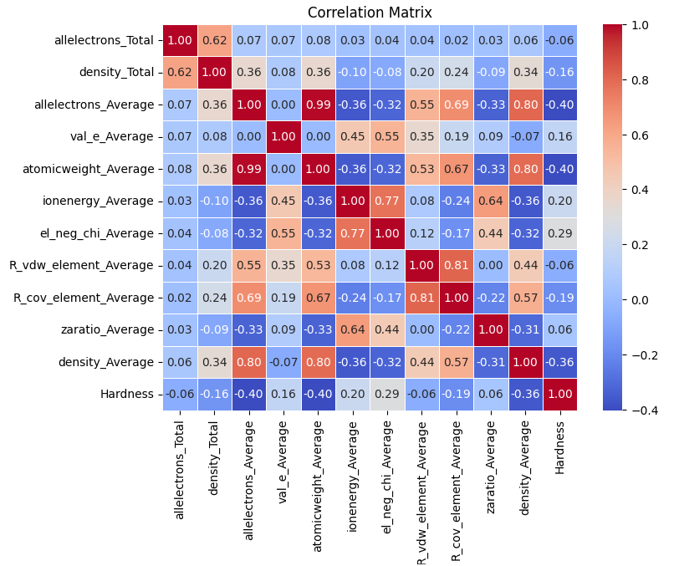
Correlation Matrix

Slide 7
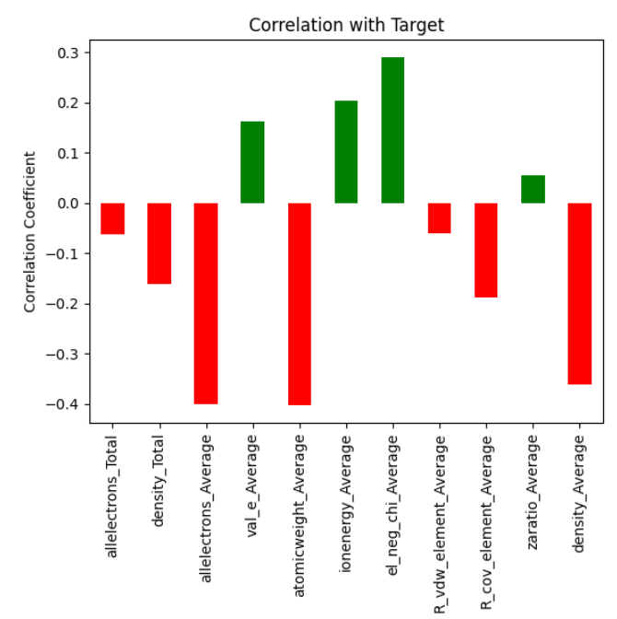
Correlation Bar Plot
Green -Positively correlated
Red- Negatively correlated

Slide 8
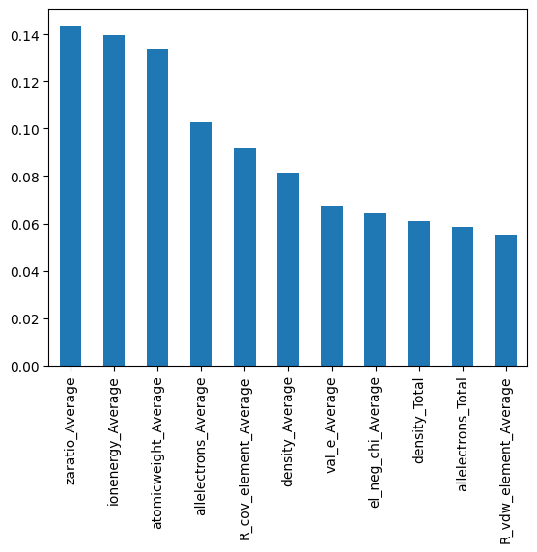
Importance of Each Attribute
Bar plot illustrates importance of each attribute to predict hardness
Zaratio_Average has highest importance
R_vdw_element_Average has lowest importance

Slide 9
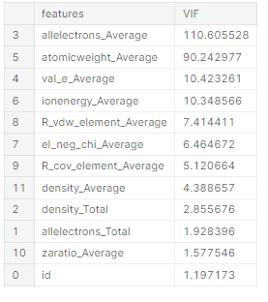
Multicollinearity
Attributes with VFI more than 10 has high risk of multicollinearity and are removed

Slide 10
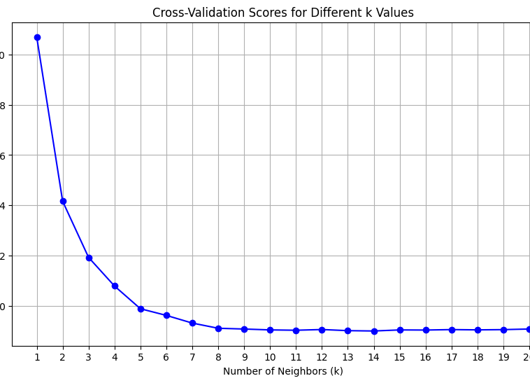
Optimal K (KNN Regressor)
K value Vs MSE plotted
K = 14 has the least MSE

Slide 11
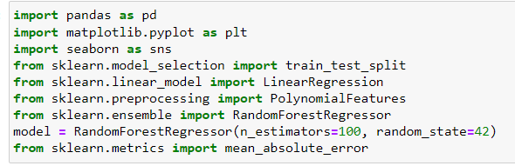
Code
Pandas is used to read the dataset
Matplotlib is used for plotting graph
Train_test split is used split the dataset into train and test data
Linear Regression, Polynomial Feature, Random Forest Regressors are imported
Mean_absolute_error imported to calculate error between predicted and actual data
Import Libraries

Slide 12
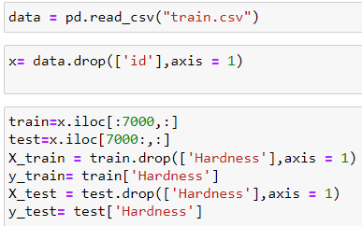
Code
Pandas is used to read the dataset
Id, Ion energy_Average,val_e_Average,
atomicweight_Average,allelectrons_Average attributes are dropped
First 7000 dataset = train
7000 - 10406 dataset = test
X_train, y_train, X_test and y_test are determined
Dataset Processing

Slide 13
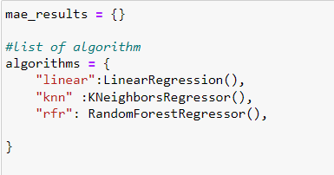
Code
Prediction by Linear, Forest Regressor, KNN neighbors Regressor

Slide 14
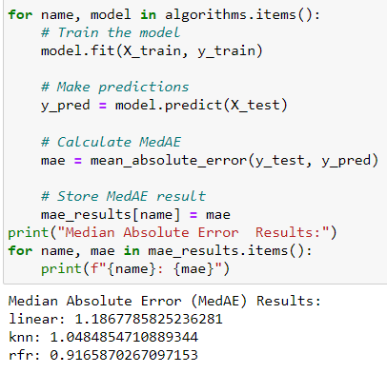
Code
Prediction by Linear, Forest Regressor, KNN neighbors Regressor
MAE
Linear Regression- 1.18
KNN Regression- 1.04
Forest Regression- 0.91

Slide 15
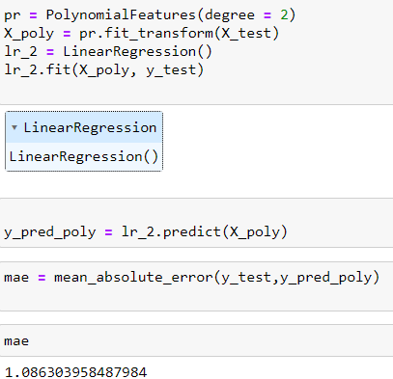
Code
Prediction by Polynomial Regression

Slide 16
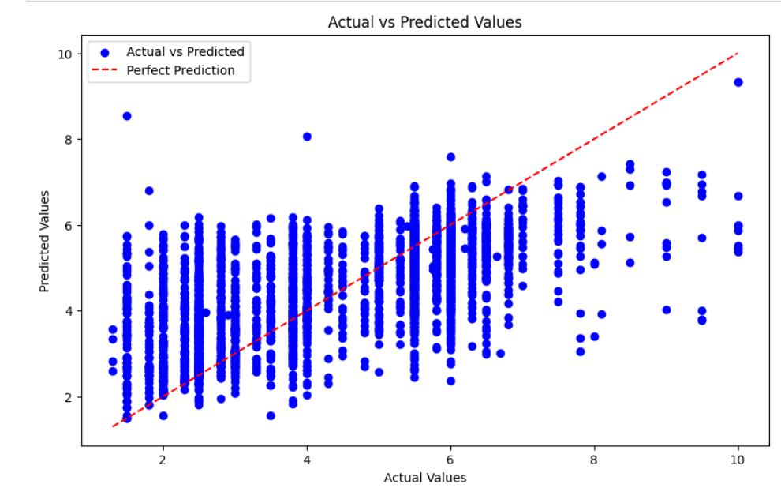
Forest Forecast Regression

Slide 17
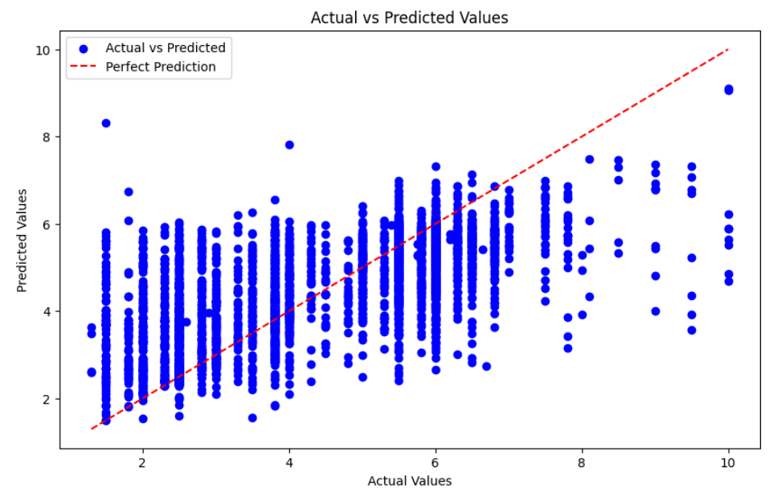
KNN Regression

Slide 18
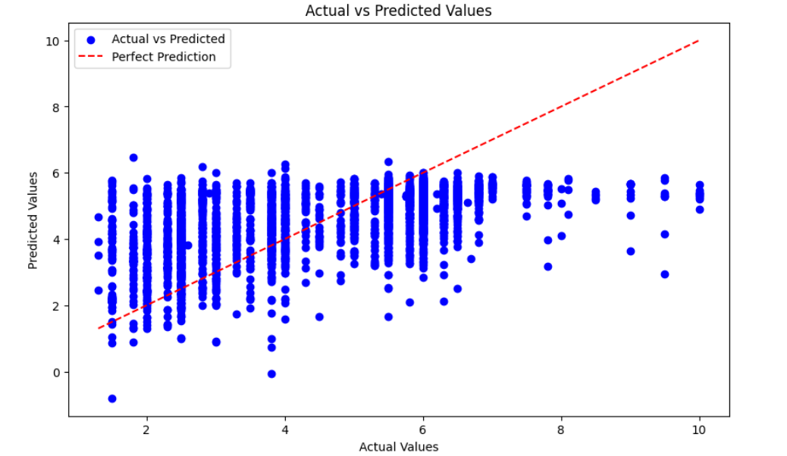
Polynomial Regression

Slide 19
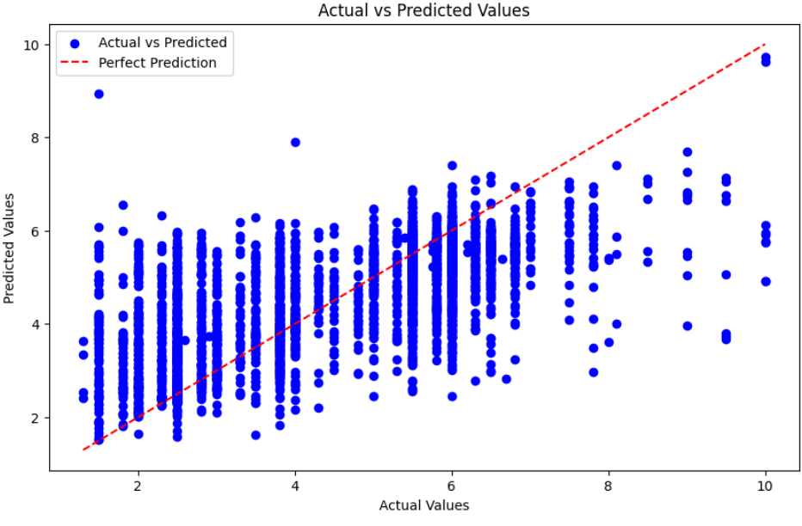
Linear Regression

Slide 20
Comparison
 | Forest Regression | KNN(k=14) | Polynomial | Linear Regression | Ideal
MSE | 1.67 | 1.67 | 1.90 | 1.7 | 0
MAE | 0.95 | 0.95 | 1.08 | 0.95 | 0
R-Square | 0.41 | 0.45 | 0.33 | 0.40 | 1

Slide 21
Conclusion
Forest Regressor is close to the ideal values of MSE, MAE and R-square
Random Forest Regression analyse Attribute importance scores. Hence Attribute with highest importance is selected.

Slide 22
Kaggle Competition
Score- 0.65
Rank - 1205/2067

Slide 23
Thank You

